Slide 1

WaterAPP
INCEDO HACKATHAN

Slide 2
Why Water Management?
Water Resource Management
Water Resource Management (WRM) is the management of water resources under set of policies and regulations. Water, once an abundant natural resource, is becoming a more valuable commodity due to droughts and overuse.
On worldwide many of cites are facing water shortage and an irregulation water supply.
Water supply & demands is always depends on area population density, water usages and water-levels in lakes, rivers & ground water levels.
So Water Management simply leads , how we efficiently used the water resources in our country for all of seasons.
Most of cities water resources management is not optimized and misleading the utilizing the water resources in improper, that’s leads to irregular water supply and water shortages.
Water Shortage & Impacts
Water shortages may be caused by climate change, such as altered weather-patterns (including droughts or floods), increased pollution, and increased human demand and overuse of water. physical (absolute) water scarcity.
A survey says world-wide more than One Million (<10L) peoples losses their life ,due to dehydration and water scarcity per year.

Slide 3
How We Do?
An efficient water resource management technology is needed for water resource planning and management
The Application should be effectively predict the future water demands on particular area with supply aspects
An application is the activity of planning, developing, distributing and managing the optimum use of water resources. It is a sub-set of water cycle management.
Ideally, water resource management planning has regard to all the competing demands for water and seeks to allocate water on an equitable basis to satisfy all uses and demands.

Slide 4
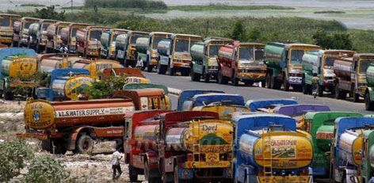
How Business Impacts?
Most of the times Water Board takes last minute decisions in supplying water due to lack of proper figures which creates lot of problems to the public and industries. As result Public suffer mostly in summer seasons.
Water Management application helps in analyzing exact demand and availability of water at each area and the most affected areas based on the water levels present at lakes and reservoirs.
So Water Board can take effective decisions by identifying areas that will be affected mostly and can take precaution or can make alternative arrangements.

Slide 5
Solutions?
Our Objective is designing the Model application for an effective Water Resource Management (WRM) based on Water Data Analysis ,Extraction and prediction.
Our WRM tool is named as WaterAPP
WaterAPP is able to calculates water availability, area population, water requirement of that area peoples and predicting the current and future water demands of that region.
WaterAPP is designed with Data Analytics and Data Prediction to make accurate prediction over 90%.
WaterAPP is automated with notifications which means it can forward the request to the Metropolitan Water Supply Board or water control board that which area requires immediate water supply thereby preventing unforeseen problems to the public.

Slide 6
Our WaterAPP Approach
The city is divided into different regions based on population density and water availability means that the water level in rivers, lakes, reservoirs, ground water level.
The Data of water resource availability , population , historical demands are feed to WaterAPP .
Historical water demands are based on data of water availability, population in that area and also based on season.
CITY
High Density & High Water Level
High Density & Low Water Level
Low Density &High Water Level
Low Density &Low Water Level
WaterAPP used a Fuzzy related decision making system for predicting the data of which area is scarce of water and requires immediate attention.
These are the areas where the demand/requirement of water is more than the availability of water. When this reaches a fixed level, the water supply board is notified that this particular area requires immediate supply of water.

Slide 7
How Data Travelling?
Data life cycle phases:
Data Loading
Data Analysis
Reporting
Data Decision
Data Archival
WaterAPP
Data Extraction
Data Decision Maker & Reporting
Data
Data Preprocessing
Data Archival
Data Analysis
Water Control Board

Slide 8
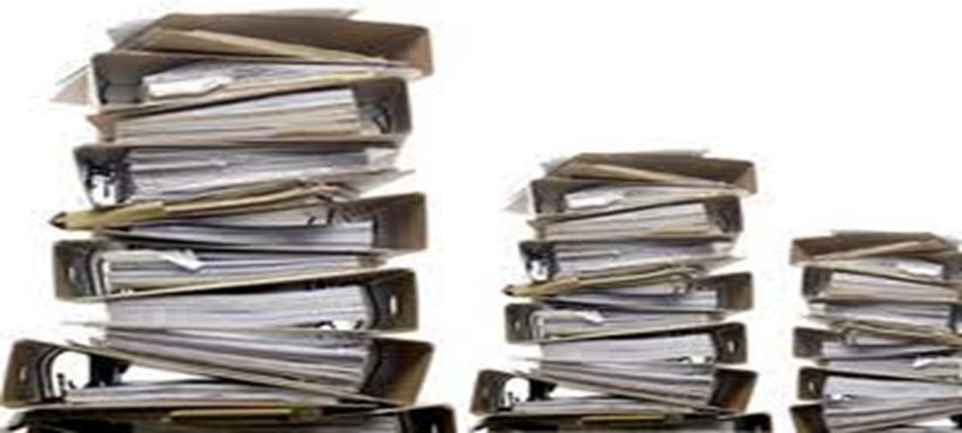
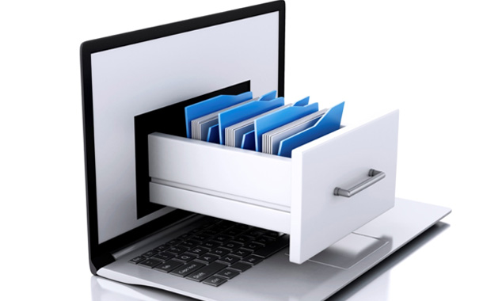
Data Phases
Data Capture
Collecting water source data and water requirement data.
Main data sources of water are rivers, lakes, rain and groundwater.
Water requirement is different across the city depending upon population, available of lakes and groundwater.
Data Storage
Once data has been collected, we can store it in a database to maintain the data and retrieve it whenever we require.
We can use the data analyze certain aspects like reliability of source, areas where more water is required etc.

Slide 9

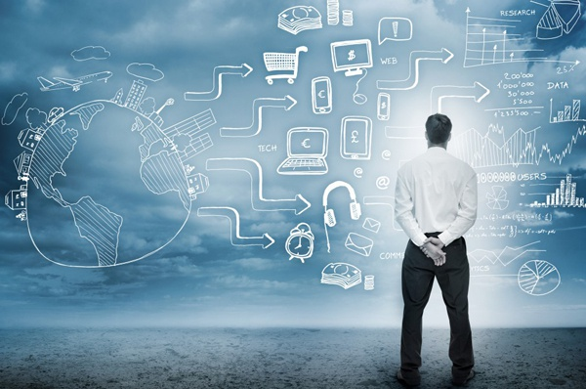
Data Analysis
Water requirement is analyze the several factors like availability of natural source, population, season etc.
The collected data is preprocessed and feed into WaterAPP decision making center to find out which areas require priority water supply.
Data Decision Center
WaterAPP used a Fuzzy related decision making system for predicting the data of which area is scarce of water and requires immediate attention.
These are the areas where the demand/requirement of water is more than the availability of water. When this reaches a fixed level, the water supply board is notified that this particular area requires immediate supply of water.

Slide 10

Data Pruning
Our data may stored in an archive in case it is needed again in an active production environment and analysis, until the removal of this data from all active production environments.
Once it is decided that the data is no longer required, every copy of a data item is removed from the database archive.

Slide 11
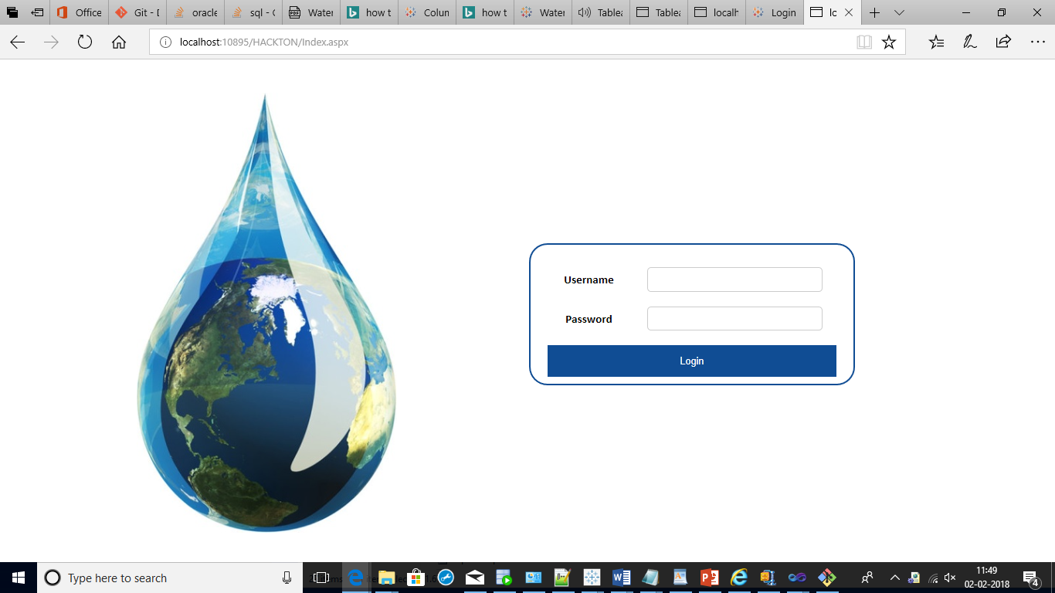
WaterApp Login

Slide 12
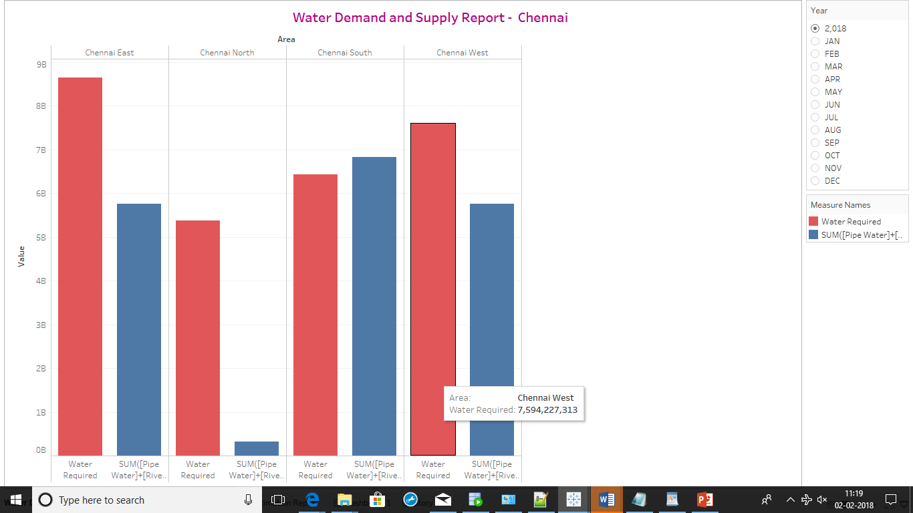
Demand & Supply Report

Slide 13
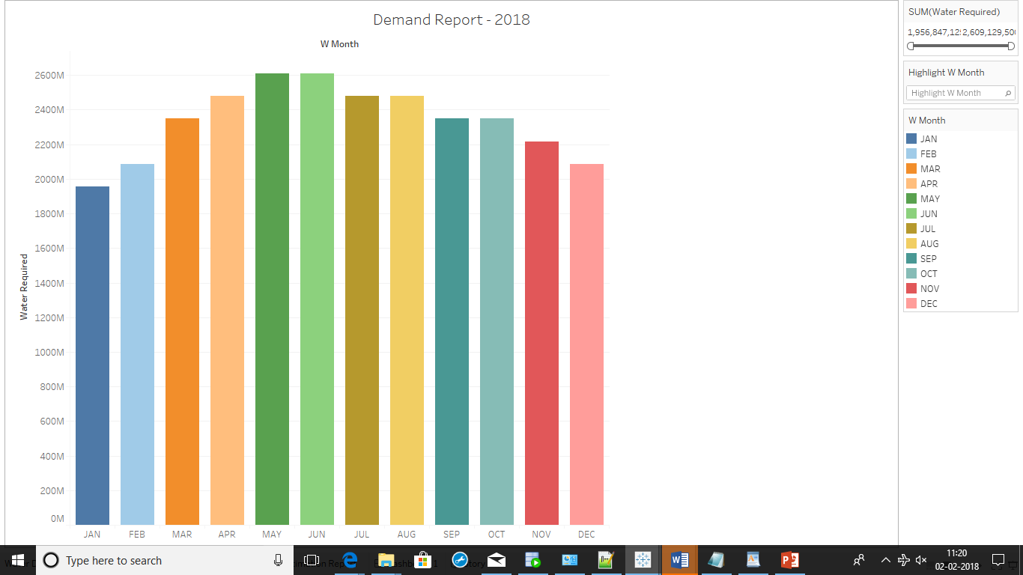
Demand Report By Monthly

Slide 14
THANK YOU

